Slide 1



Capstone Project Phase B
24-1-D-40
Nitsan Maman
Ron Shahar
Advisor: PhD. Sulamy Moshe

Slide 2
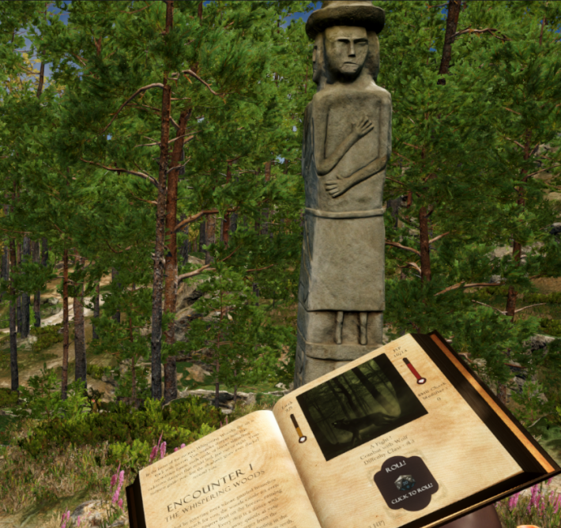
Introduction – What is TaleWeaver?
AI-Driven Dynamic Storytelling Game.
Personalized storytelling experiences.
Adaptive game world for better immersion.
An adventure set in the forest

Slide 3
The Problems
Decline in book reading.
Traditional Games often rely on fixed narratives. making replayability low once the story is complete.

Slide 4
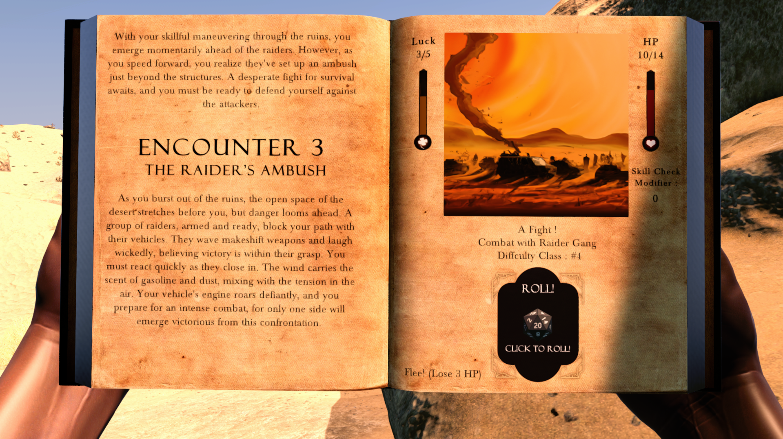
Our Approach
An Immersive game that allows players to actively shape their story.
An adventure set in the desert

Slide 5
Main System Requirements
Generate story adventures using AI
Six core gameplay mechanics to provide meaningful interaction with the AI-generated story.
Dynamic game world that change based on each page.

Slide 6
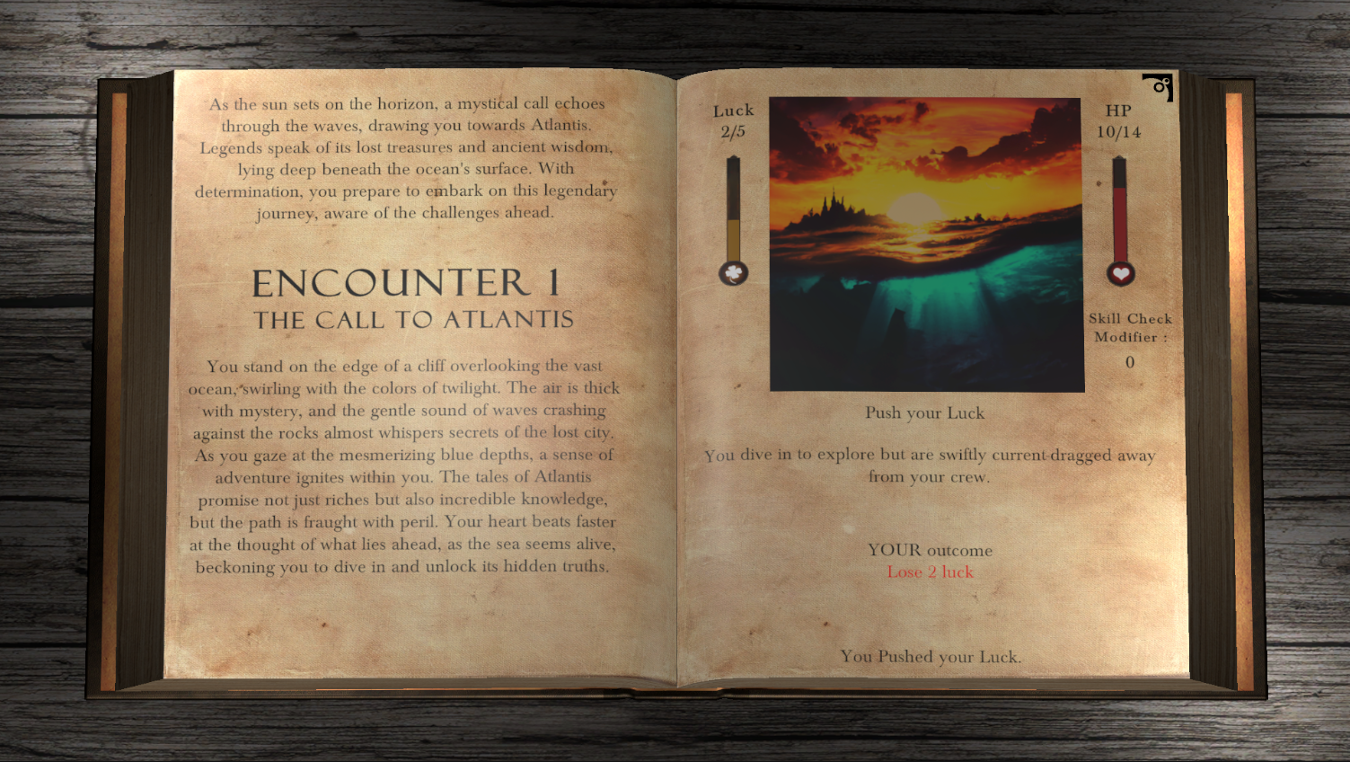
Technologies
Custom AI Model Integration
RAKE Keyword Extraction Algorithm
View Previous adventures screen

Slide 7
Custom AI Model Integration
Seamless interaction with gameplay mechanics.
AI generates structured outputs, guiding the game parser to recognize mechanics.
Ensures smooth transitions between story elements and gameplay.

Slide 8
Custom AI Model Integration
AI receives instructions detailing upcoming mechanics, including type, difficulty, and player status.
We predefine the gameplay loop, and the AI generates a story around it.
The game scripts integrates AI-generated content into gameplay, ensuring that the player actions drive the narrative and mechanics in a cohesive experience.

Slide 9
RAKE Algorithm
Extracts keywords from the AI-generated story.
Tailoring the game world environment.
Each page seamlessly transitions to the most immersive pre-made environment based on story elements.

Slide 10









Tools Used
Unity Game Engine
Visual Studio / NUnit
Git / Git LFS / GitHub
Postman / OpenAI Assistance Webpage
Photoshop / Unity Asset Store
Inno Setup

Slide 11
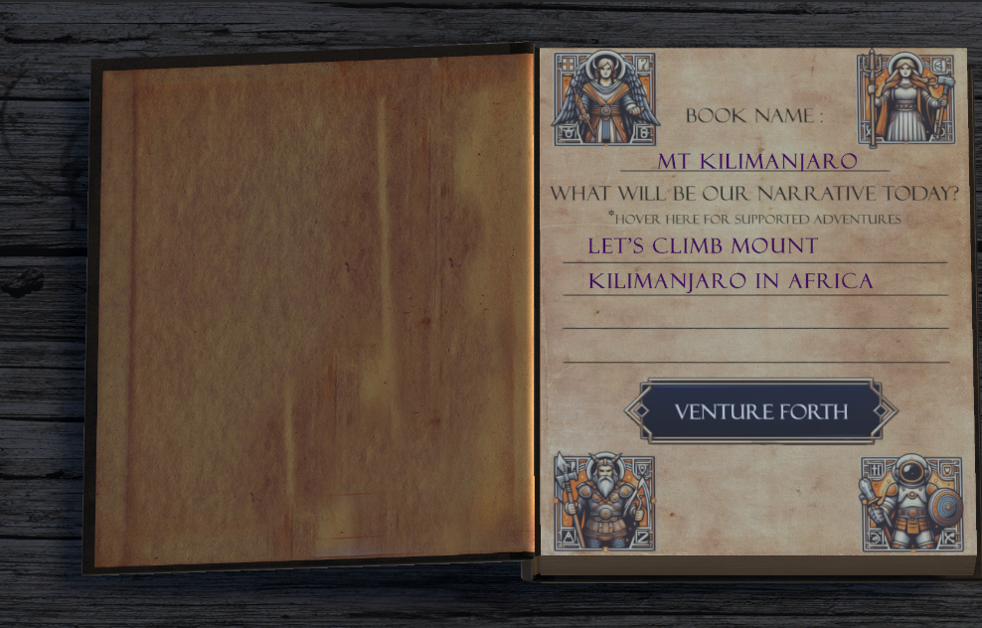
Challenges Faced
Data Management: Parsing JSON files from OpenAI API.
Book Animations: Achieving smooth page transitions.
UI Button Integration: Creating seamless fade-in/out buttons.
Create new adventure screen

Slide 12
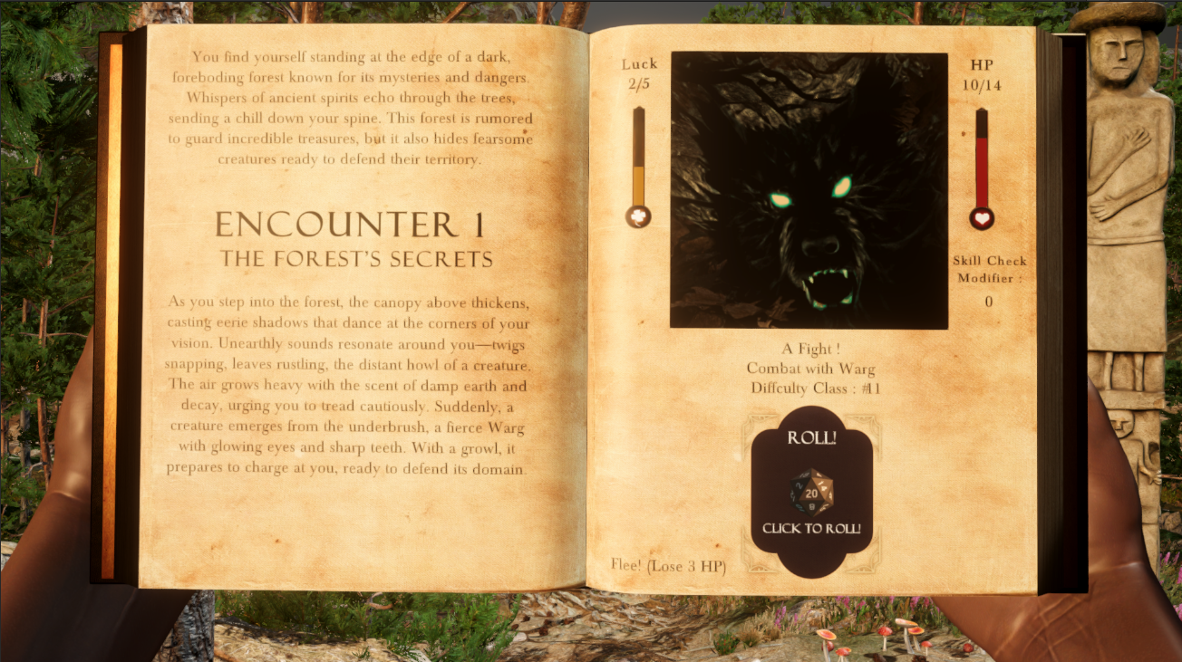
Challenges Faced
Expanding Gameplay Mechanics: Introducing varied mechanics like luck, roll, combat, choices.
API Costs: Saved generated content to reduce OpenAI API usage during testing.
AI Response Consistency: Developed intelligent parsing to ensure data reliability, Error Handler.
Combat Mechanic

Slide 13
Project Metrics - Achieved
AI Integration: We achieved seamless integration with OpenAI.
Gameplay Mechanics: We Successfully implemented six core mechanics.
Game Worlds / Scalability: Handles multiple locations and adventures, can be easily expanded.
Visual Design: We created a visually engaging interface.

Slide 14
Project Metrics – Not Achieved
Sound Keywords: Sound wasn’t dynamically altered from extracted keywords.
Usability: Some users found the interface non-intuitive. (Added How to Play)
Reward System: We couldn’t implement motivating rewards due to time constraints.

Slide 15
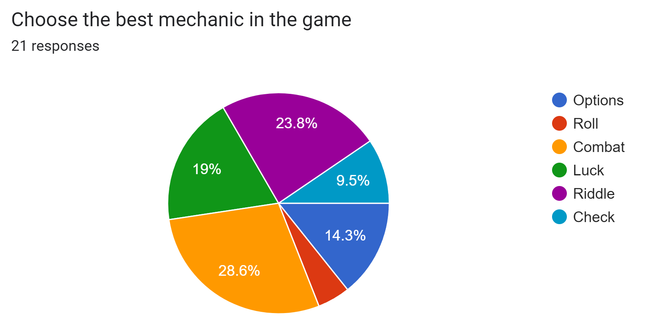
User Feedback
We let around 20 players to play our game prior to release.

Slide 16
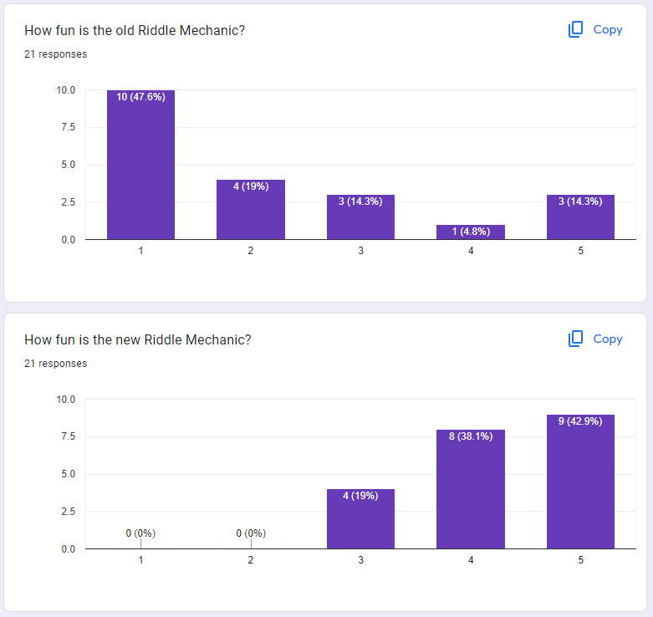
User Feedback
Problem: Riddle Mechanic became repetitive.
Rather than remove riddles, we added more variety and logic.

Slide 17
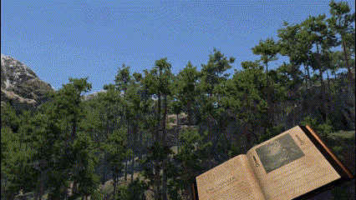
User Feedback
Problem: Some worlds did not match the weather and time of day of the story.
We add a weather / time of day system and let the player choose the time and weather.

Slide 18
Future Expansion
Open World Interactions: Expand content while waiting for new story pages to load.
AI generation: Faster AI generation will enhance gameplay flow and experience.
Adaptive Weather/Time of Day: adapt the weather and time of day according to the story.

Slide 19
Game Videos

Slide 20
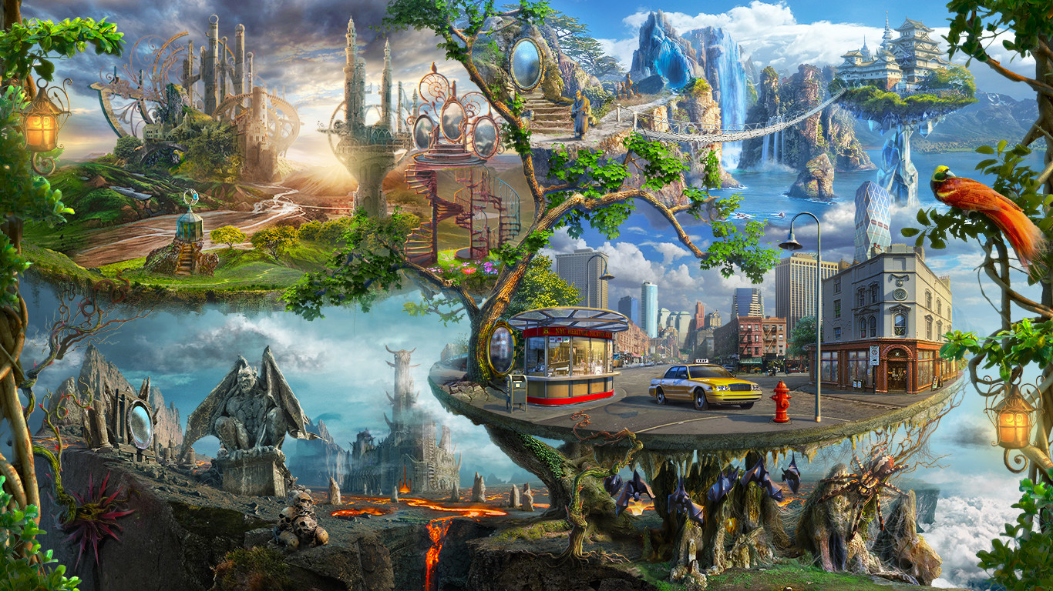

Slide 21
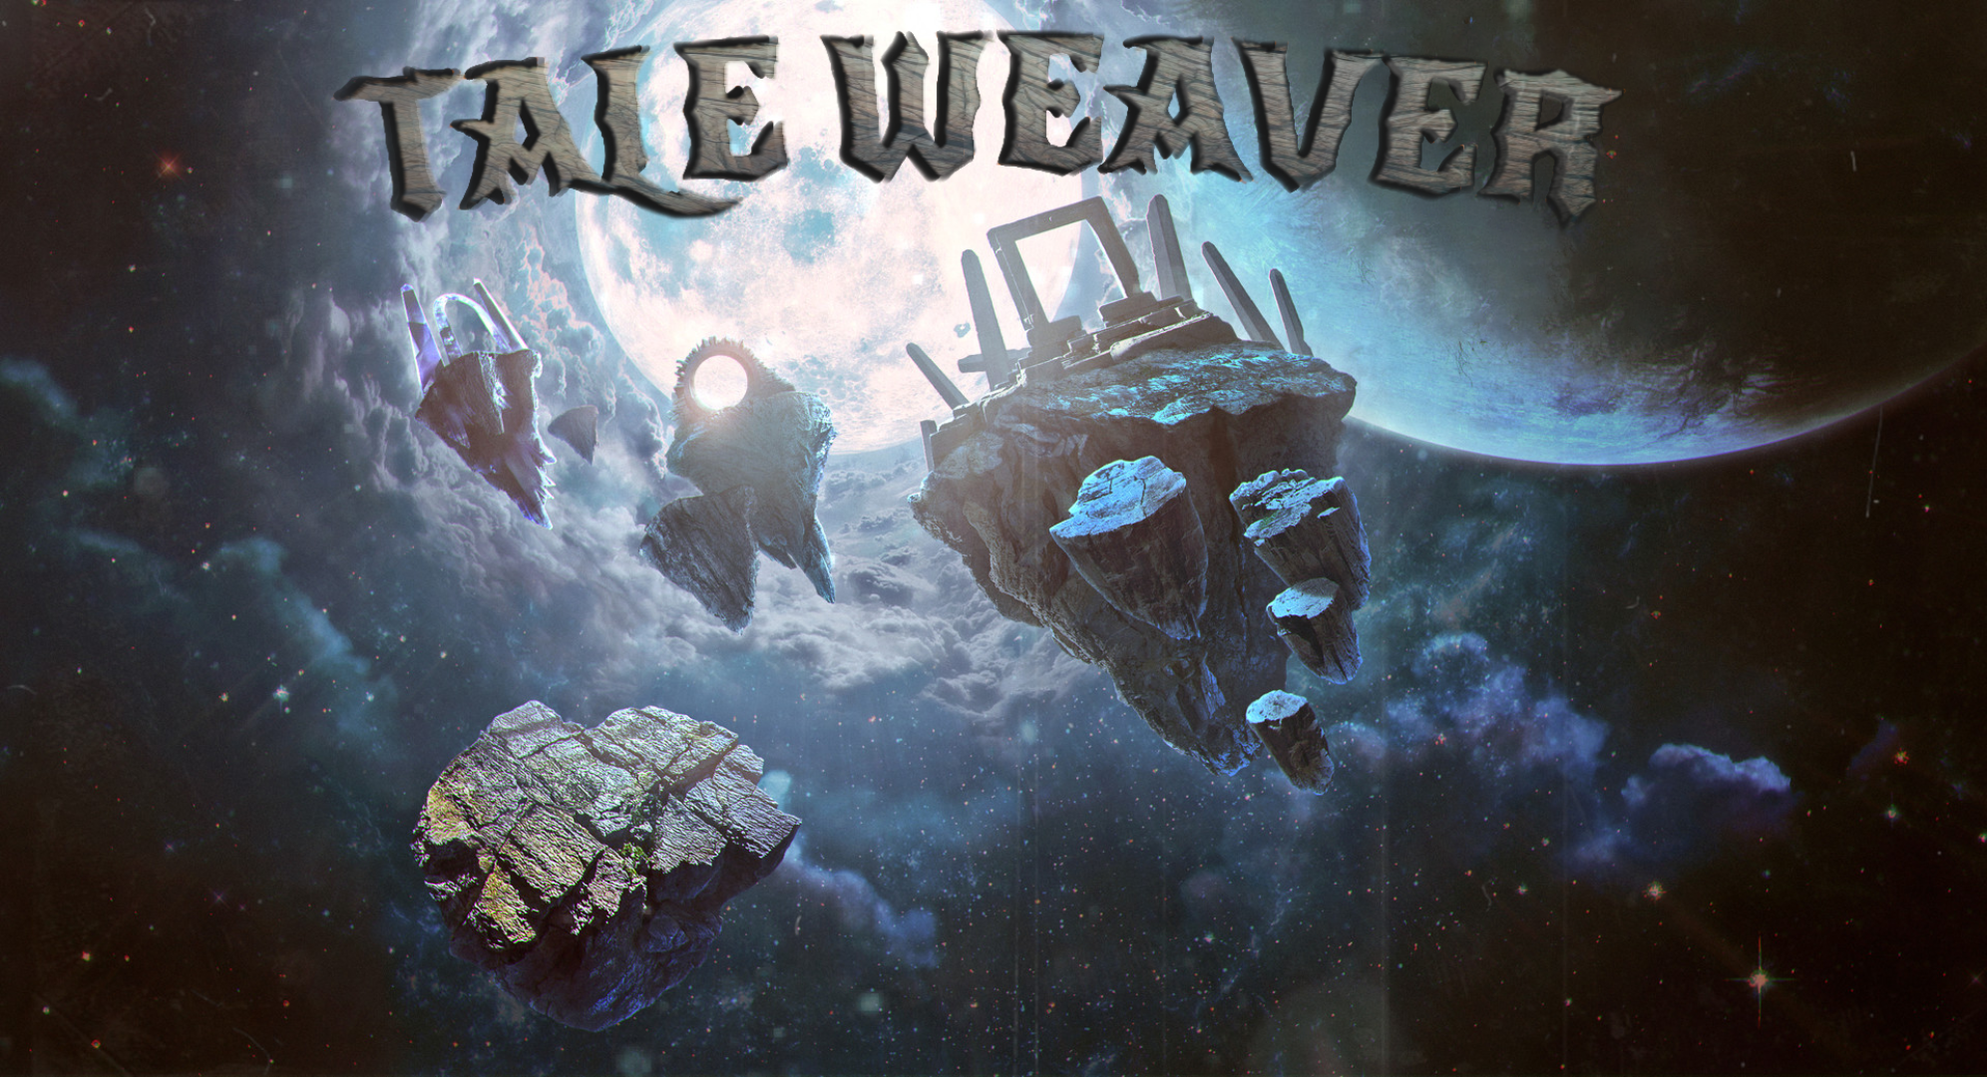

Slide 22
Live Demo

Slide 23

THANK YOU!
Any questions?

